Slide 1

6th Grade Accelerated Math
Unit 10, Lesson 3 Justifying Measures of Center and Variation Volume 2, pg. 116

Slide 2


Benchmarks
MA.6.DP.1.6
Given a real-world scenario, determine and describe how changes in data values impact measures of center and variation.
MA.7.DP.1.1
Determine an appropriate measure of center or measure of variation to summarize numerical data, represented numerically or graphically, taking into consideration the context and any outliers.
volume 2, pg. 116

Slide 3
Integrated Mathematical Thinking and Reasoning Standards
MA.K12.MTR.2.1 Demonstrate understanding by representing problems in multiple ways.
MA.K12.MTR.7.1 Apply mathematics to real-world contexts.
volume 2, pg. 116

Slide 4

Learning Target
I can justify whether or not a measure of center or variation appropriately summarizes data.
volume 2, pg. 116

Slide 5

Warm-Up
volume 2, pg. 116

Slide 6
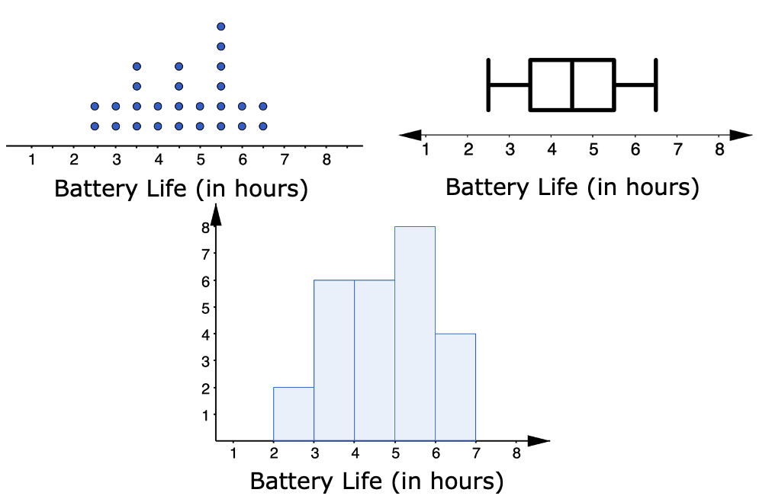
10.3.1 Warm-Up: Notice and Wonder
The dot plot, histogram, and box plot summarize the hours of battery life for $26$ cell phones that are constantly streaming videos.
volume 2, pg. 116

Slide 7
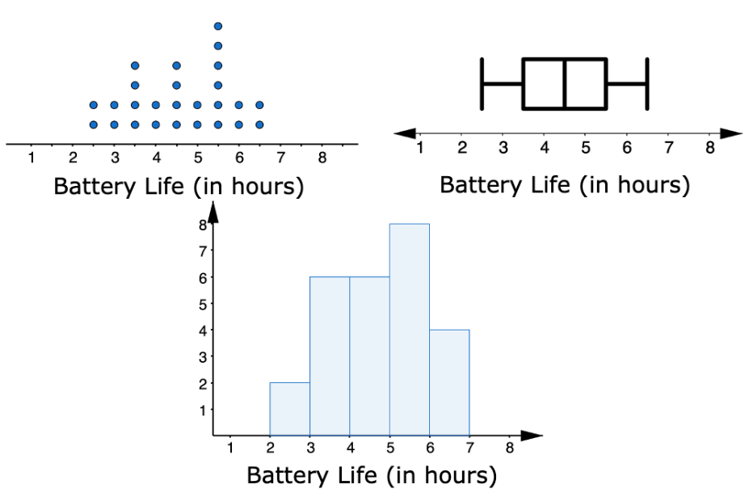
What do you notice?
What do you wonder?
volume 2, pg. 116

Slide 8

Collaboration
volume 2, pg. 117

Slide 9

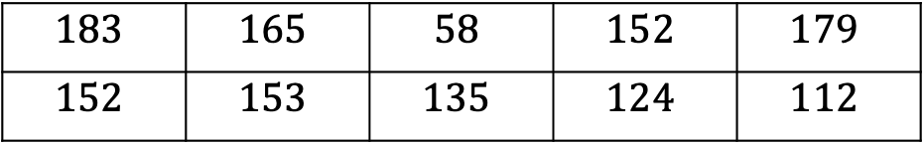
10.3.2 Collaboration: Comparing Data Displays
Suppose an office tracks the number of phone calls received on business days, Monday through Friday, over two weeks. The data set is shown below.
Discuss with your partner what you notice about the data set.
$$183$$ | $$165$$ | $$58$$ | $$152$$ | $$179$$
$$152$$ | $$153$$ | $$135$$ | $$124$$ | $$112$$
volume 2, pg. 117

Slide 10
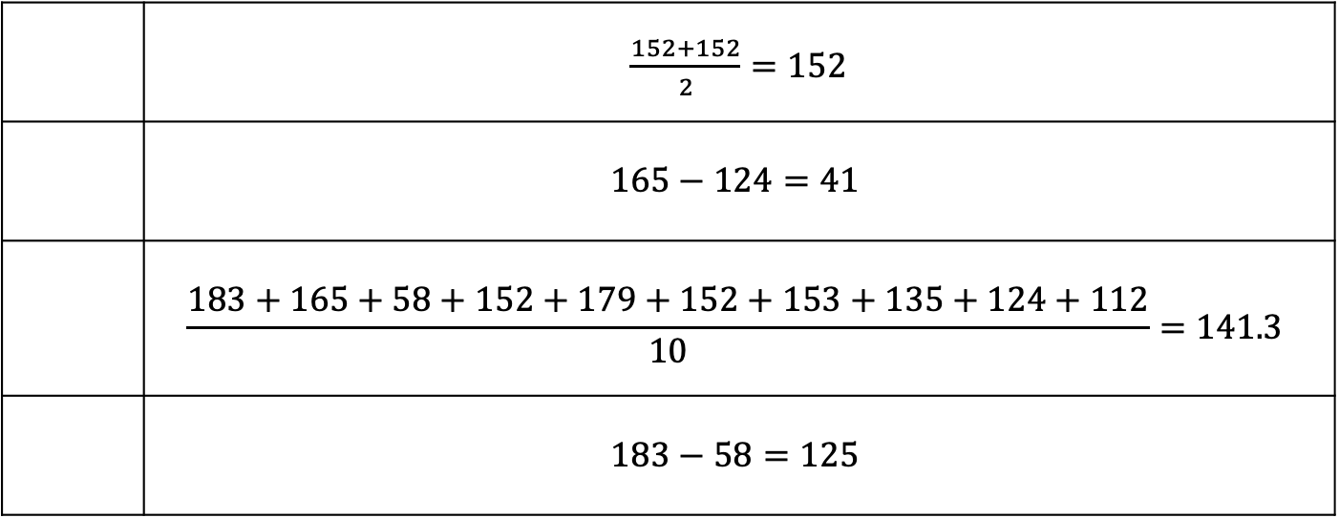
Match the measures of center and variation with their calculations for the data set above.
Mean | Median | Range | IQR
 | $\frac{152+152}{2}=152$
 | $$165−124=41$$
 | $$\frac{183+165+58+152+179+152+153+135+124+112}{10}=141.3$$
 | $$183−58=125$$
volume 2, pg. 117

Slide 11
A histogram, line plot, and box plot representing the data are shown.
Label the display types
by filling in the box above
each display.
volume 2, pg. 117

Slide 12
Complete the table by identifying which measures of center and variation can be determined from each display.
Describe any outliers in the data set.
 | Mean | Median | Range | IQR
Histogram
Line Plot
Box Plot
volume 2, pg. 118

Slide 13
Explain which of the displays you used to determine whether or not there was an outlier in the data set.
volume 2, pg. 118

Slide 14

Guided Instruction
volume 2, pg. 118

Slide 15

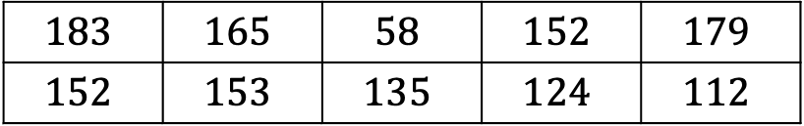
10.3.3 Guided Instruction: Stem-and-Leaf Plots
Recall the data collected on the number of phone calls an office received on business days over two weeks.
In addition to displaying the data graphically with a histogram, line plot, or box plot, the data can also be displayed in a stem-and-leaf plot.
$$183$$ | $$165$$ | $$58$$ | $$152$$ | $$179$$
$$152$$ | $$153$$ | $$135$$ | $$124$$ | $$112$$
A stem-and-leaf plot is a table that organizes data by place value to compare data frequencies.
volume 2, pg. 118

Slide 16
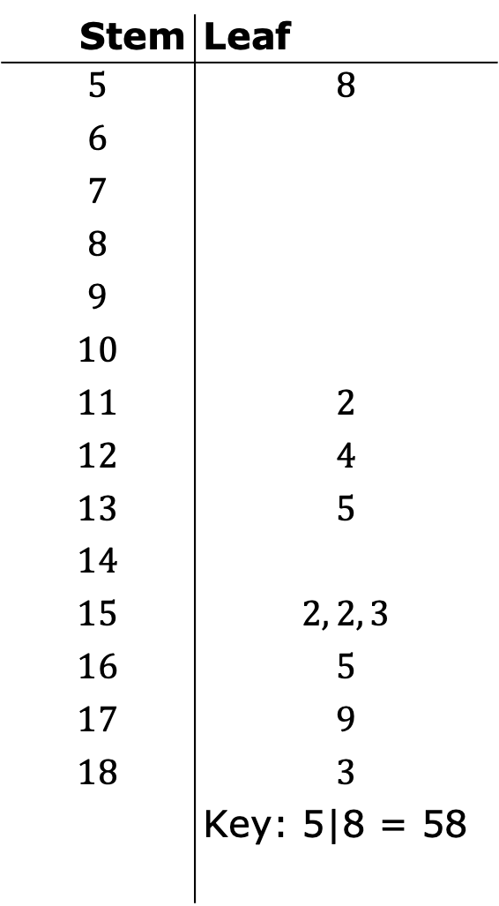
What do you notice about the data in the stem-and-leaf plot?
Stem | Leaf
$$5$$ | $$8$$
$$6$$
$$7$$
$$8$$
$$9$$
$$10$$
$$11$$ | $$2$$
$$12$$ | $$4$$
$$13$$ | $$5$$
$$14$$
$$15$$ | $$2, 2, 3$$
$$16$$ | $$5$$
$$17$$ | $$9$$
$$18$$ | $$3$$
 | Key: 5|8 = 58
volume 2, pg. 118

Slide 17

Compare the stem-and-leaf plot with the line plot from the collaboration.
What value does the entry $13|5$ represent?
What similarities do you notice between the displays? | What differences do you notice between the displays?
volume 2, pg. 119

Slide 18
Which measure(s) of center can be determined from the stem-and-leaf plot?
Which measure(s) of variation can be determined from the stem-and-leaf plot?
mean
median
both the mean and median
range
interquartile range
both the range and the interquartile range
volume 2, pg. 119

Slide 19
Collaboration
volume 2, pg. 119

Slide 20
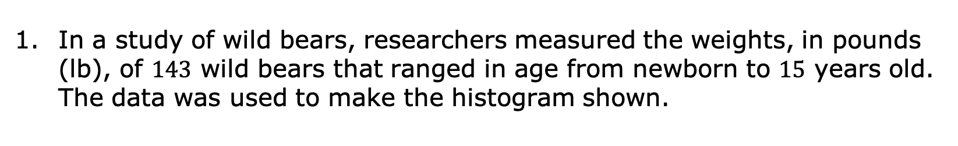
10.3.4 Collaboration: Center and Variation in Context
In a study of wild bears, researchers measured the weights, in pounds (lb), of $143$ wild bears that ranged in age from newborn to $15$ years old. The data was used to make the histogram shown.
Wild Bear Weight
Weight (pounds)
volume 2, pg. 119

Slide 21
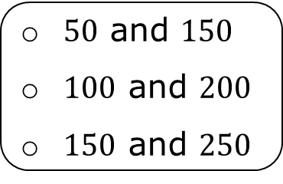
Complete the statements.
Based on the data, it appears wild bears typically
weigh between pounds. A good
estimate for the typical weight for wild bears is
__________ pounds.
$50$ and $150$
$100$ and $200$
$150$ and $250$
Wild Bear Weight
Weight (pounds)
volume 2, pg. 119

Slide 22
Compare your estimate with your partner. Discuss whether it is possible for both of your estimates to be reasonable, even if they are not the same.
Discuss with your partner whether your estimate from Part A is closer to the median or the mean. Summarize your discussion.
volume 2, pg. 120

Slide 23
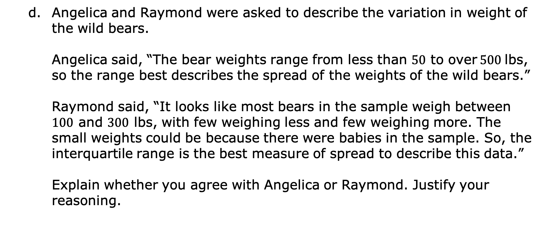
Angelica and Raymond were asked to describe the variation in weight of the wild bears.
Angelica said, “The bear weights range from less than $50$ to over $500$ lbs, so the range best describes the spread of the weights of the wild bears.”
Raymond said, “It looks like most bears in the sample weigh between $100$ and $300$ lbs, with few weighing less and few weighing more. The small weights could be because there were babies in the sample. So, the interquartile range is the best measure of spread to describe this data.”
Explain whether you agree with Angelica or Raymond. Justify your reasoning.
volume 2, pg. 120

Slide 24
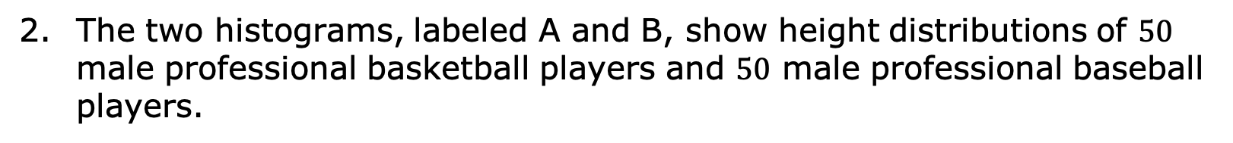
The two histograms, labeled A and B, show height distributions of $50$ male professional basketball players and $50$ male professional baseball players.
Histogram A: Heights of Professional Basketball Players
Height (in inches)
Histogram B: Heights of Professional Baseball Players
Height (in inches)
volume 2, pg. 120

Slide 25
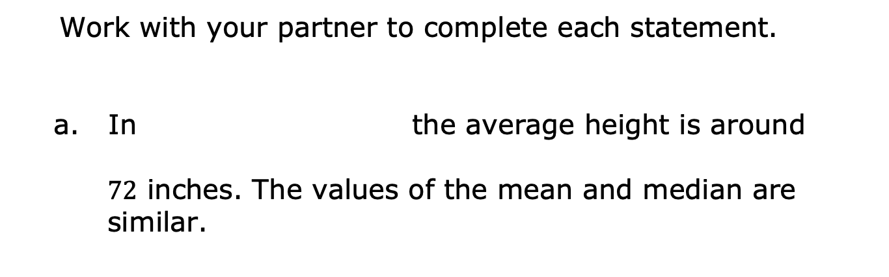
Work with your partner to complete each statement.
In the average height is around
$72$ inches. The values of the mean and median are similar.
Histogram A,
Histogram B,
Histogram A: Heights of Professional Basketball Players
Histogram B: Heights of Professional Baseball Players
Height (in inches)
Height (in inches)
volume 2, pg. 120

Slide 26
To explain typical height, the variation in
is best described by the
interquartile range because the range may be misleading due to outliers. The values of the mean and median are similar.
Histogram A,
Histogram B,
Histogram A: Heights of Professional Basketball Players
Histogram B: Heights of Professional Baseball Players
Height (in inches)
Height (in inches)
volume 2, pg. 120

Slide 27
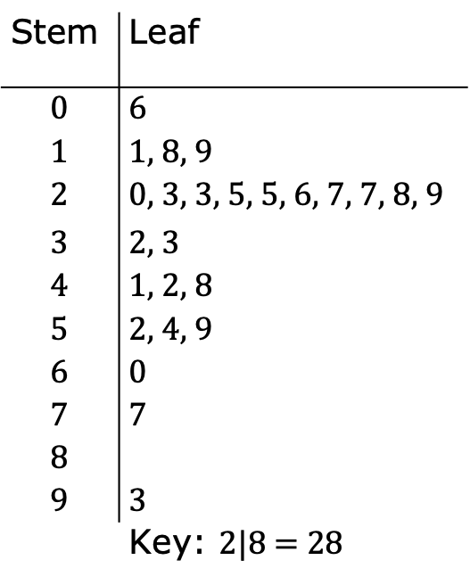
An earthworm farmer set up several containers of a certain species of earthworm so he could learn about their lengths. Lengths of earthworms provide information about their ages. The farmer measured the lengths of the earthworms in one container.
The farmer displayed the earthworms’ lengths, in millimeters (mm), in a stem-and-leaf plot.
Stem | Leaf
$$0$$ | 6
$$1$$ | 1, 8, 9
$$2$$ | 0, 3, 3, 5, 5, 6, 7, 7, 8, 9
$$3$$ | 2, 3
$$4$$ | 1, 2, 8
$$5$$ | 2, 4, 9
$$6$$ | 0
$$7$$ | 7
$$8$$
$$9$$ | 3
 | Key: $2$|8 = 28
volume 2, pg. 121

Slide 28
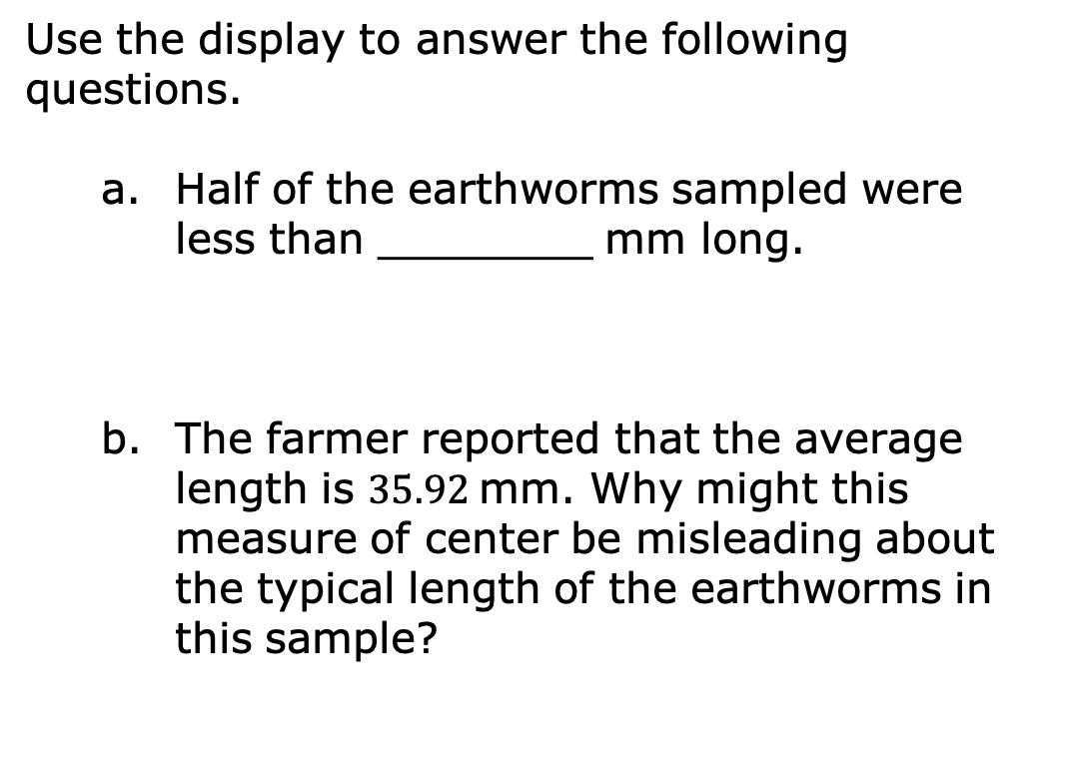
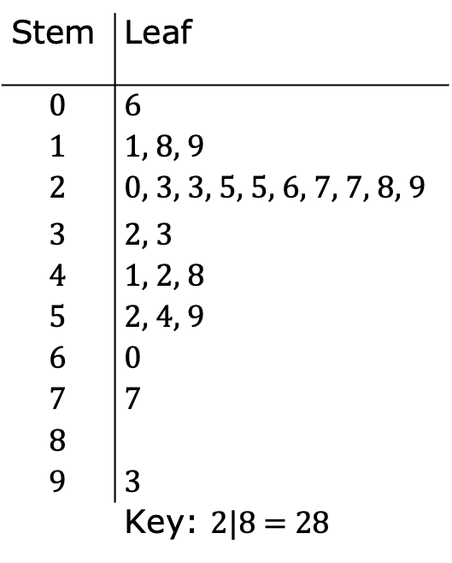
Use the display to answer the following questions.
Half of the earthworms sampled were less than ________ mm long.
The farmer reported that the average length is $35.92$ mm. Why might this measure of center be misleading about the typical length of the earthworms in this sample?
Stem | Leaf
$$0$$ | 6
$$1$$ | 1, 8, 9
$$2$$ | 0, 3, 3, 5, 5, 6, 7, 7, 8, 9
$$3$$ | 2, 3
$$4$$ | 1, 2, 8
$$5$$ | 2, 4, 9
$$6$$ | 0
$$7$$ | 7
$$8$$
$$9$$ | 3
 | Key: $2$|8 = 28
volume 2, pg. 121

Slide 29
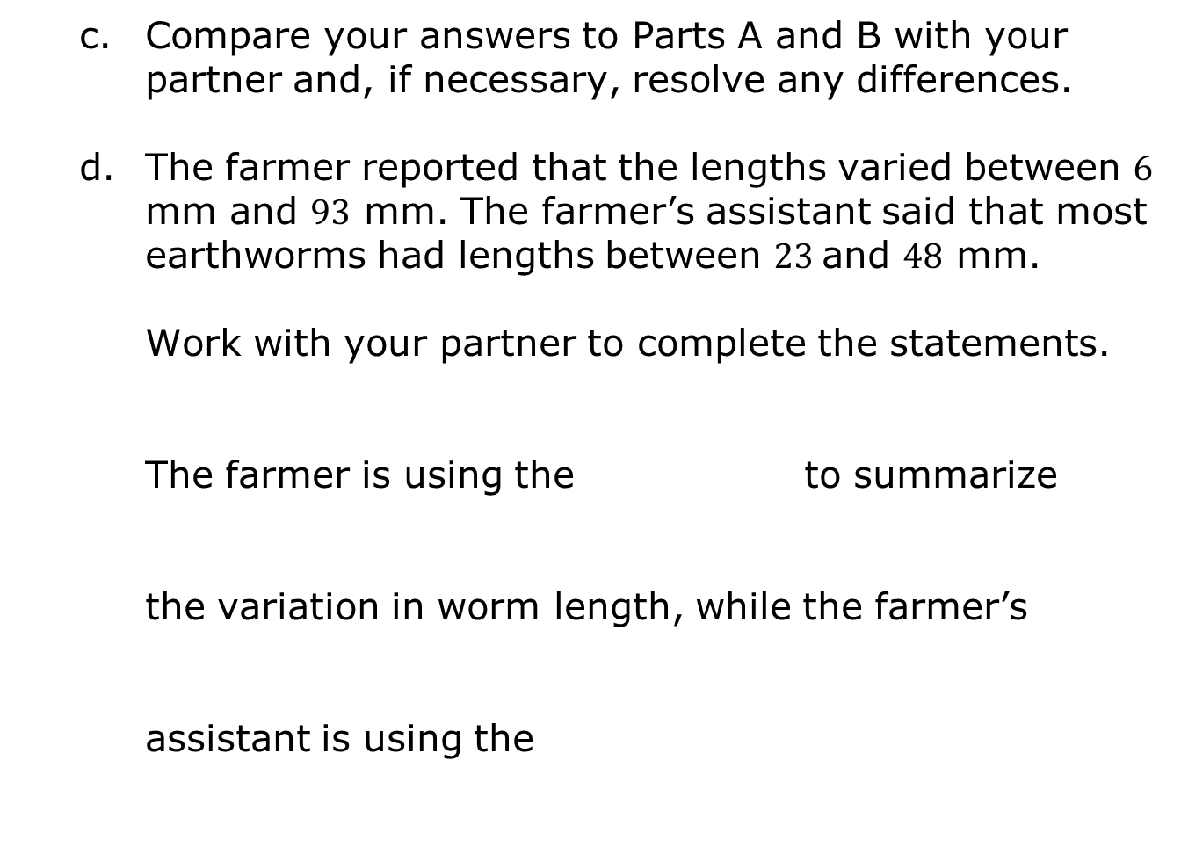
Compare your answers to Parts A and B with your partner and, if necessary, resolve any differences.
The farmer reported that the lengths varied between $6$ mm and $93$ mm. The farmer’s assistant said that most earthworms had lengths between $23$ and $48$ mm.
Work with your partner to complete the statements.
The farmer is using the to summarize
the variation in worm length, while the farmer’s
assistant is using the
IQR
range
IQR.
Range.
volume 2, pg. 121

Slide 30
If a researcher is interested in how long
earthworms are, the is an
appropriate measure of variation for the farmer
to report because .
IQR
range
volume 2, pg. 121

Slide 31

Wrap-Up
volume 2, pg. 122

Slide 32
10.3.5 Wrap-Up: Reflection
Draw an X on the line to indicate where your current learning is in relation to the following learning targets.
I can justify whether or not a measure of center
appropriately summarizes data.
I can justify whether or not a measure of variation
appropriately summarizes data.
I need help. I can’t get started. | I’m getting there, but I need more practice. | I understand this and I feel confident.
I need help. I can’t get started. | I’m getting there, but I need more practice. | I understand this and I feel confident.
volume 2, pg. 122

